Slide 1

Quiz Application
Sakshi Thorbole (21204003)
Tanishq Sahane (20104072)
Tejas Patil (20104123)
Project Guide
Prof. Shital Agrawal

Slide 2
Contents
Introduction
Objectives
Scope
Literature Survey
Proposed System
Project Outcomes
Block Diagram
Use Case/DFD
Technology Stack
Suggestions in Review-1
Result and Discussion
Conclusion and Future Scope
References

Slide 3
1. Introduction
Problem Identified:
  The Quiz Application project is developed to overcome the time consuming problem of manual system.
  Apart from that, in existing system, checking the answer sheets was wasting much time.
Solution Proposed:
    This application will check the correct answer and save the examiner time and carry the examination in an effective manner.
    The users which use this system don’t need high computing knowledge and also system will inform them entering.

Slide 4
2. Objectives
The main objective of the project Quiz Application is to mange the score of user.
The project is totally at administrative end and thus only the administrator can grant the access.
To create an appropriate platform for best managing of MCQ test.
To overcome the time consuming issues and taking MCQ test.
To overcome manual efforts.

Slide 5
3. Scope
Can be used by educational institutions as well as in corporate.
Can reduce the manual work for managing the MCQ.
Can be used anywhere, any time as it is a web based application.
Can be used to increase users knowledge.

Slide 6
4. Literature Survey
At least literature survey of three research paper related to specific area in which project is done.
[Paper1]: The main theme of this app is to save the time while conducting examinations. Generally, to conduct exam we need so much infrastructure, but here if we have the application installed is enough for the examination. Up to now we take examinations on paper, the idea to take examinations in our device led us to creation of the application. Earlier, correction of the answers is also a big problem to correct manually so our application gets rid of the heavy work of correcting each and every answer in manual way.
[Paper2]: Although there are number of Web-Based applications which are, one way or other related to quiz, however, there only few that help in learning and contributing to the academic enhancement of the students. Most of the available applications are aiming at having a fun or entertainment. Among the many applications, we review some Web based applications that are quite famous and are successful.

Slide 7
5. Proposed System
Feature 1: There will be random set of questions for each user.
The question will be different for all the users and jumbled.
Feature 2: After marking the answer, it will notify correct/incorrect answer.
When you submit answer it will prompt that if the question is correct or wrong.
Feature 3: There will be certain time slot allotted for execution of quiz.
There will be given time to complete the quiz.
Feature 4: Result will be declared after end of quiz.
Marks will be displayed at the end of the quiz.
Feature 5: Certificate will be generated.
Certificate will be generated after giving the exam.

Slide 8
6. Outcome of Project
User can log in.
User can select courses.
User can start, attempt and view the result.
Admin can enroll.
Only enrolled users will be able to login.

Slide 9
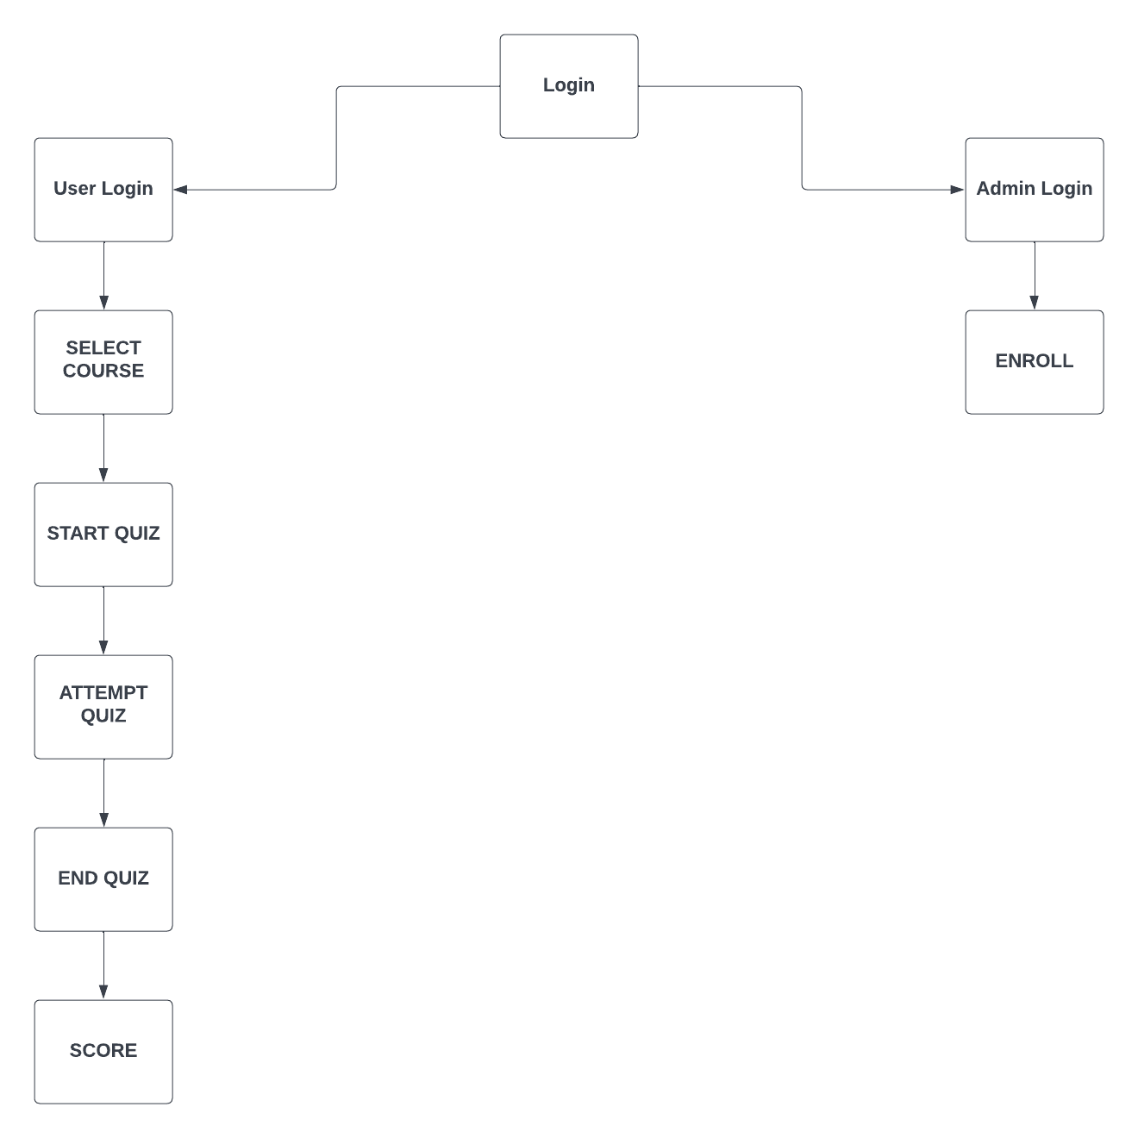
7. Block Diagram

Slide 10
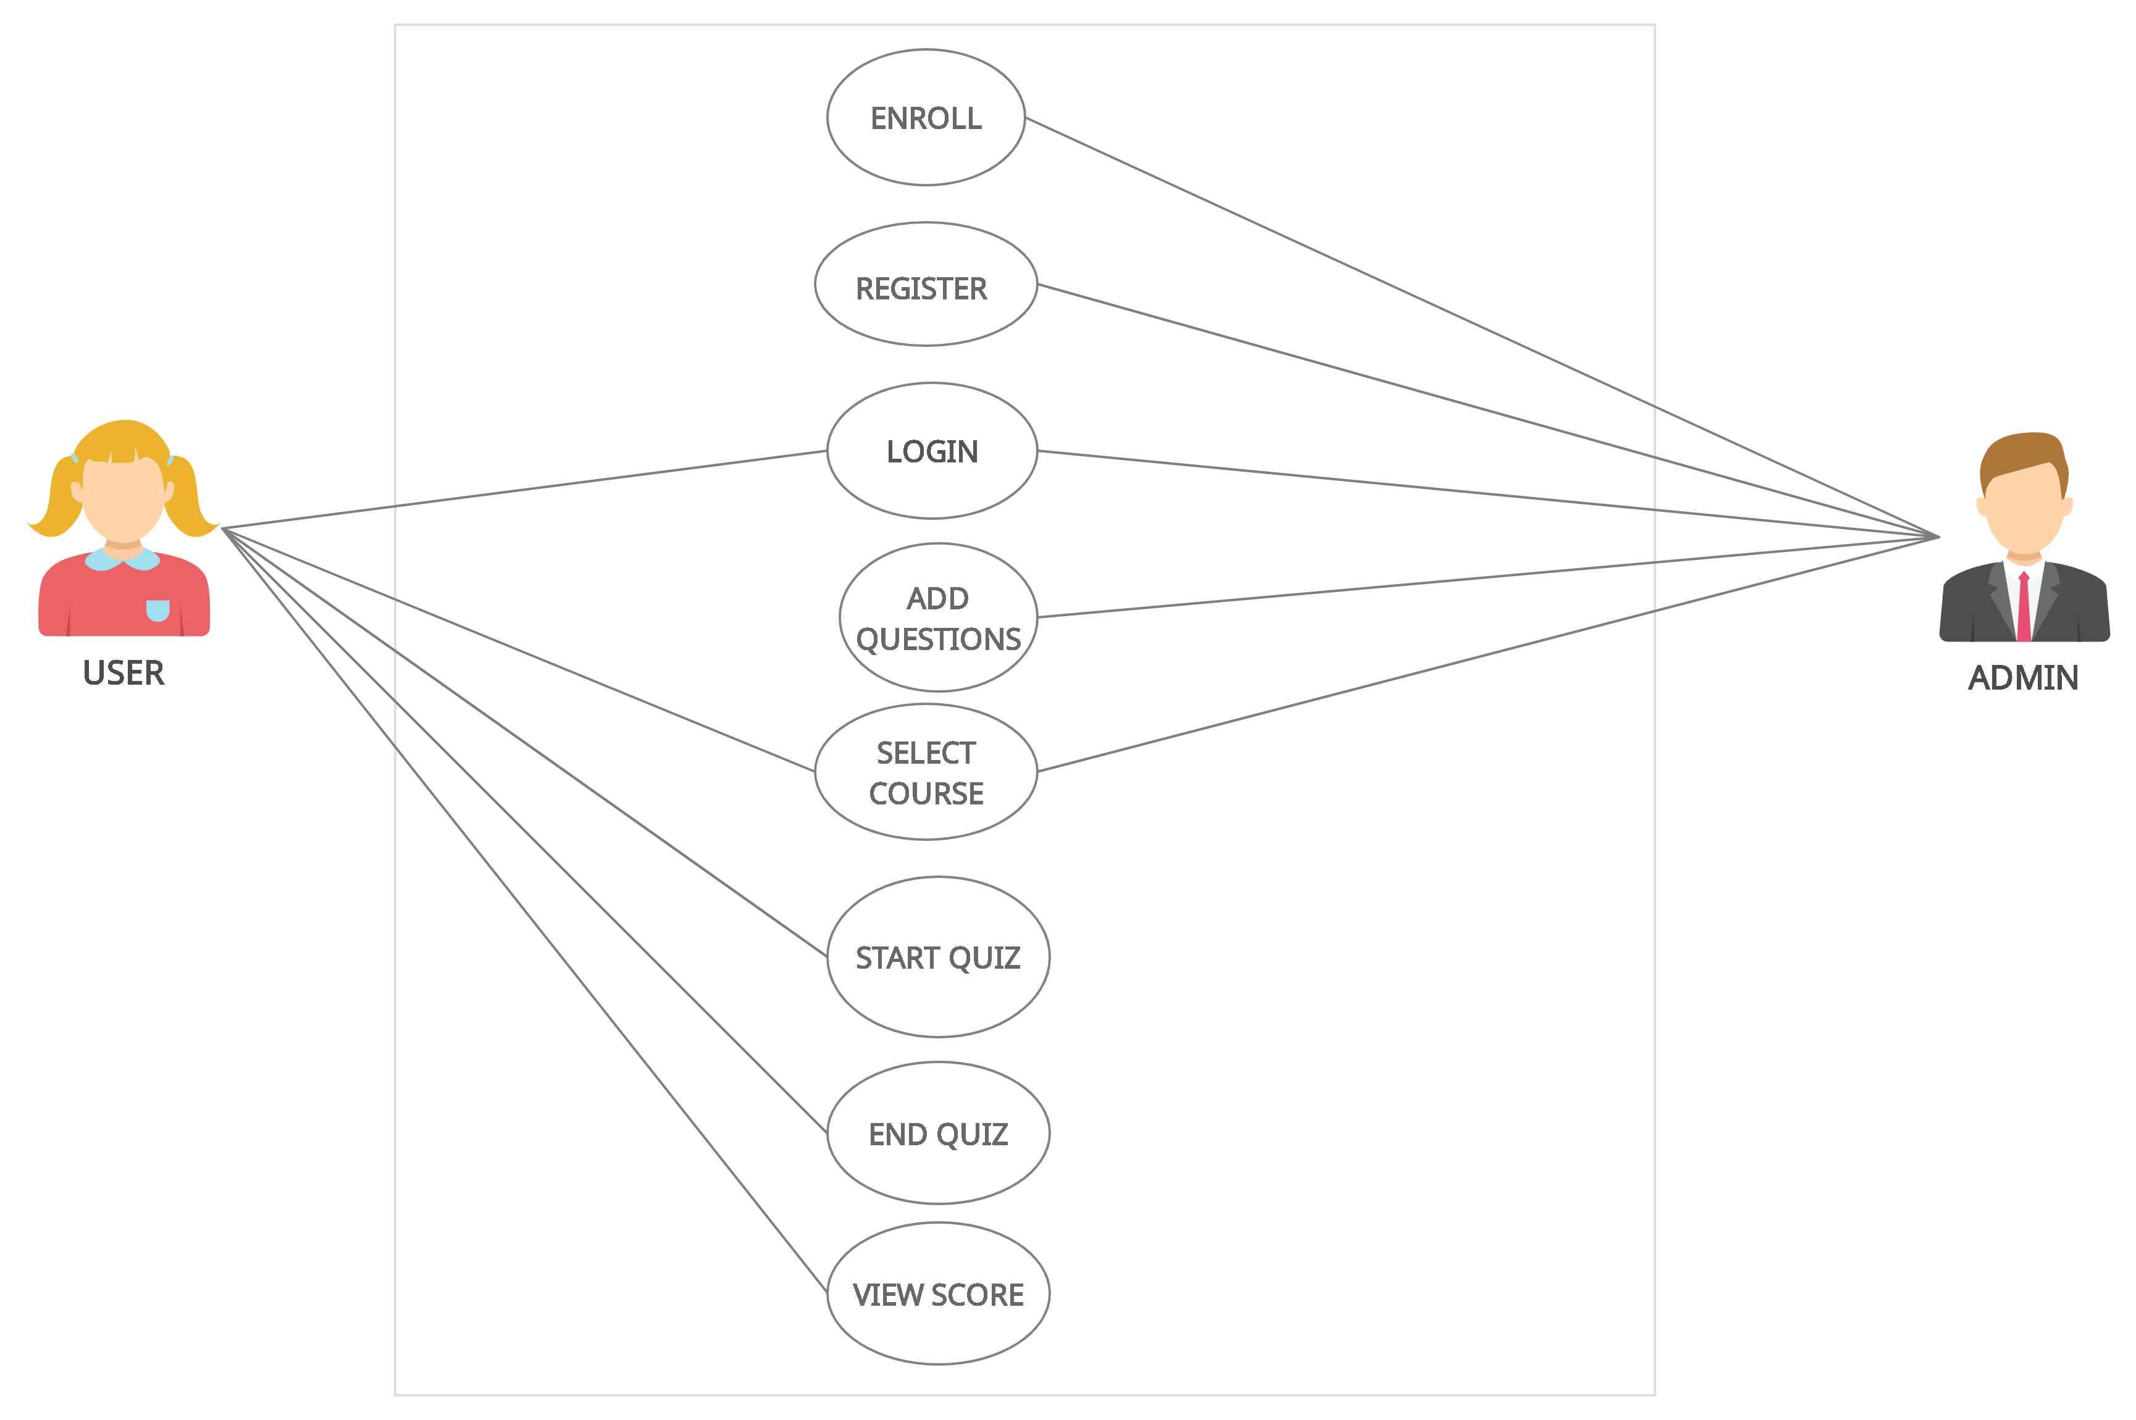
8. Use Case Diagram

Slide 11




9. Technology Stack
FRONTEND – HTML, CSS , JS
BACKEND – MySQL
IDE – VS CODE

Slide 12
Suggestions in Review-1
Add Scoreboard
Certificate generation.
Cognitive Level Exams.

Slide 13
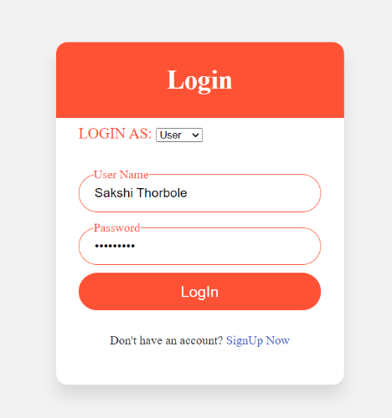
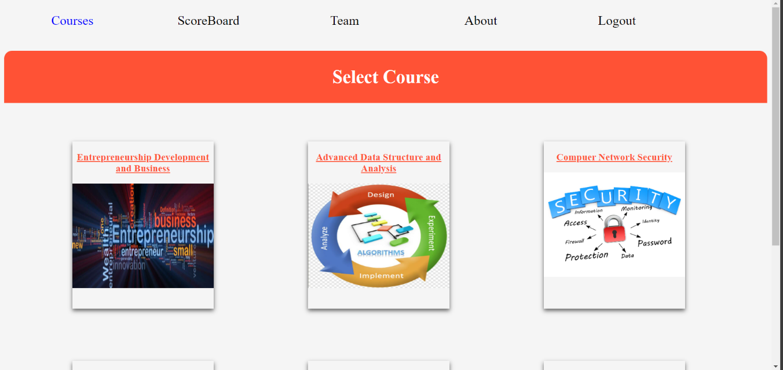
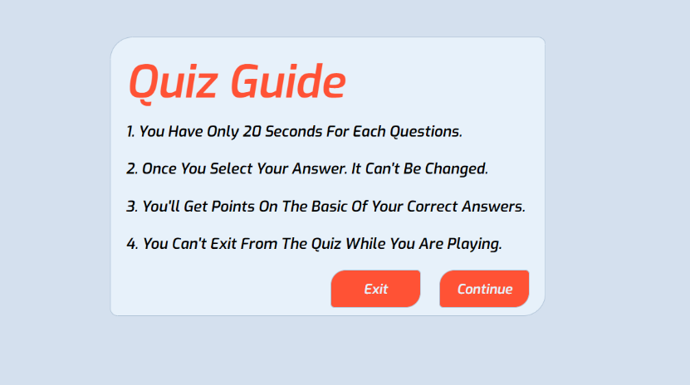
Result and Discussion

Slide 14
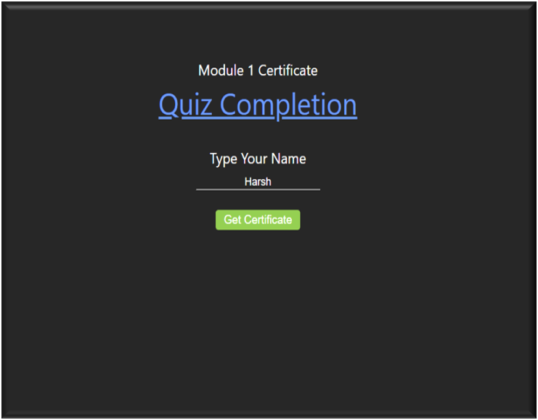
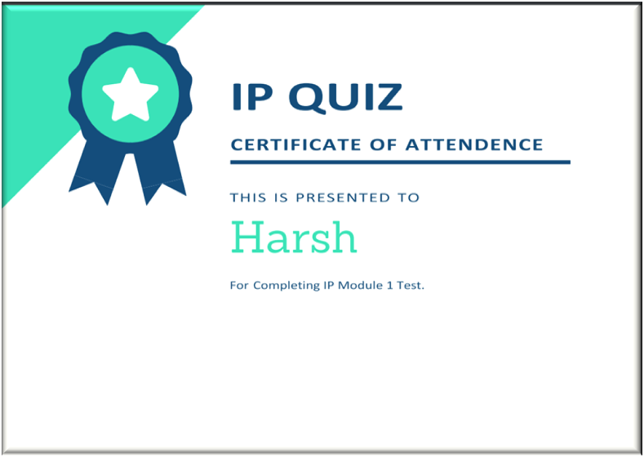

Slide 15
Conclusion and Future Scope
Quiz Application project is only for MCQ test but in the future we have plan to extend it to support subjective type of questions with more functionality. We will add Administrative part on it which able the system to delete test, add user, delete user and so on graphically view the web.
To conclude, this is a simple Quiz Application where some part will be store in SQL Server database and the user will able to attempt the quiz. The marks of the user will be calculated according to questions they attempt and will be displayed by the system.

Slide 16
References
https://www.researchgate.net/publication/303896969_Quizzy_Quiz_Applicatio n_development_using_Android_Plartform
http://www.warse.org/IJETER/static/pdf/Issue/icacsse2016sp56.pdf
https://www.academia.edu/34579184/Quiz_Contest_A_Quiz_Application_A_P ROJECT_REPORT_Submitted_by_NAME

Slide 17
Thank You...!!

